Slide 1
Introduction of Planning

Slide 2
问题
设市场上可买到n种不同的食品，第j种食品单位售价为c_{j}，每种食品含有m种基本营养成分，第j种食品每一个单位含第i种营养成分为a_{ij}。又设每人每天对第i种营养成分的需求量不少于b_{i}。试确定在保证营养要求条件下的最经济食谱。
请建立食谱问题的数学模型。
注意分析：决策变量、目标、约束条件。

Slide 3
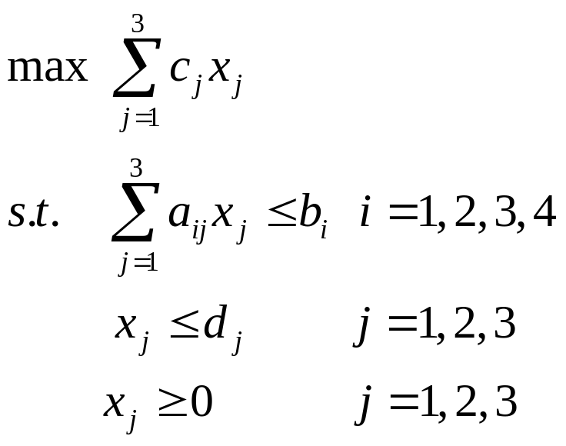
线性规划
满足约束条件，使目标函数值最大。
数学模型如下：
线性规划问题：目标函数和约束函数都是线性的。

Slide 4
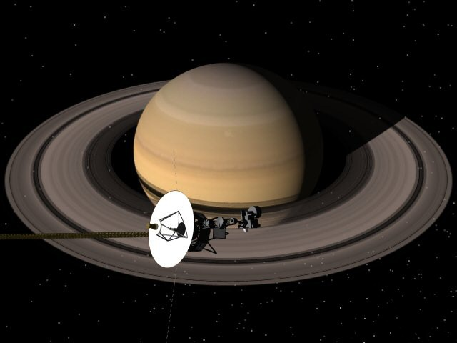
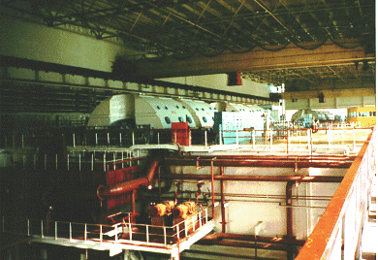
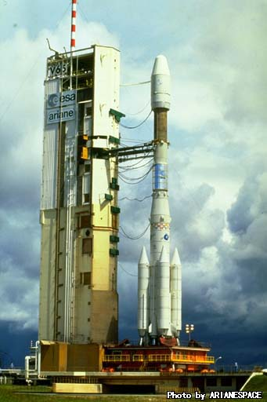
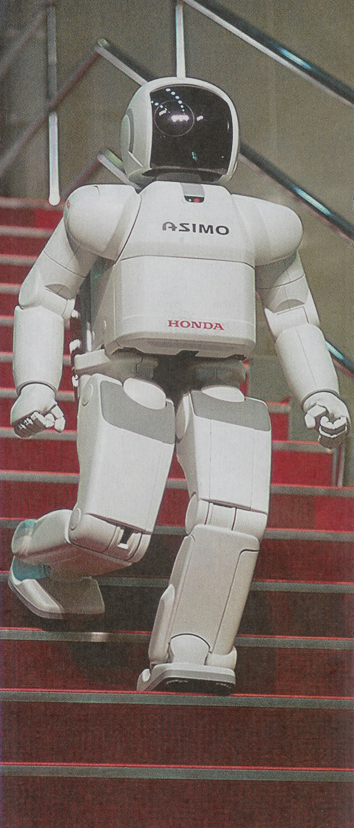
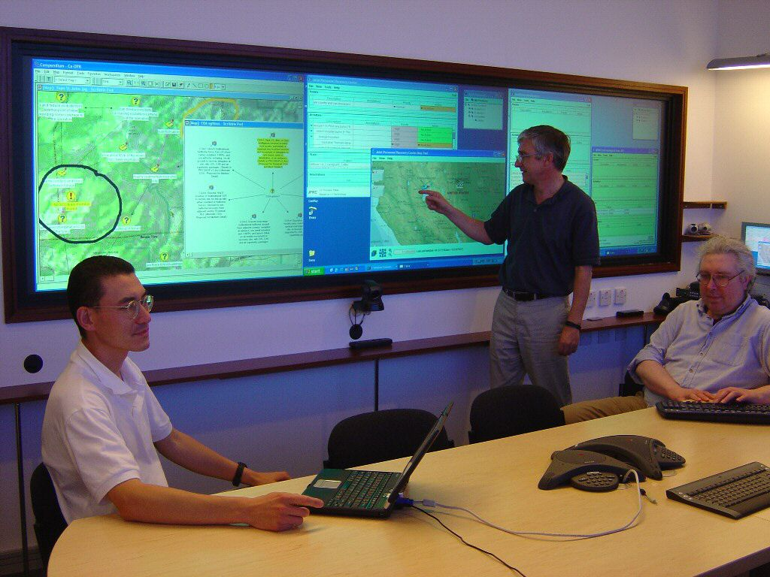




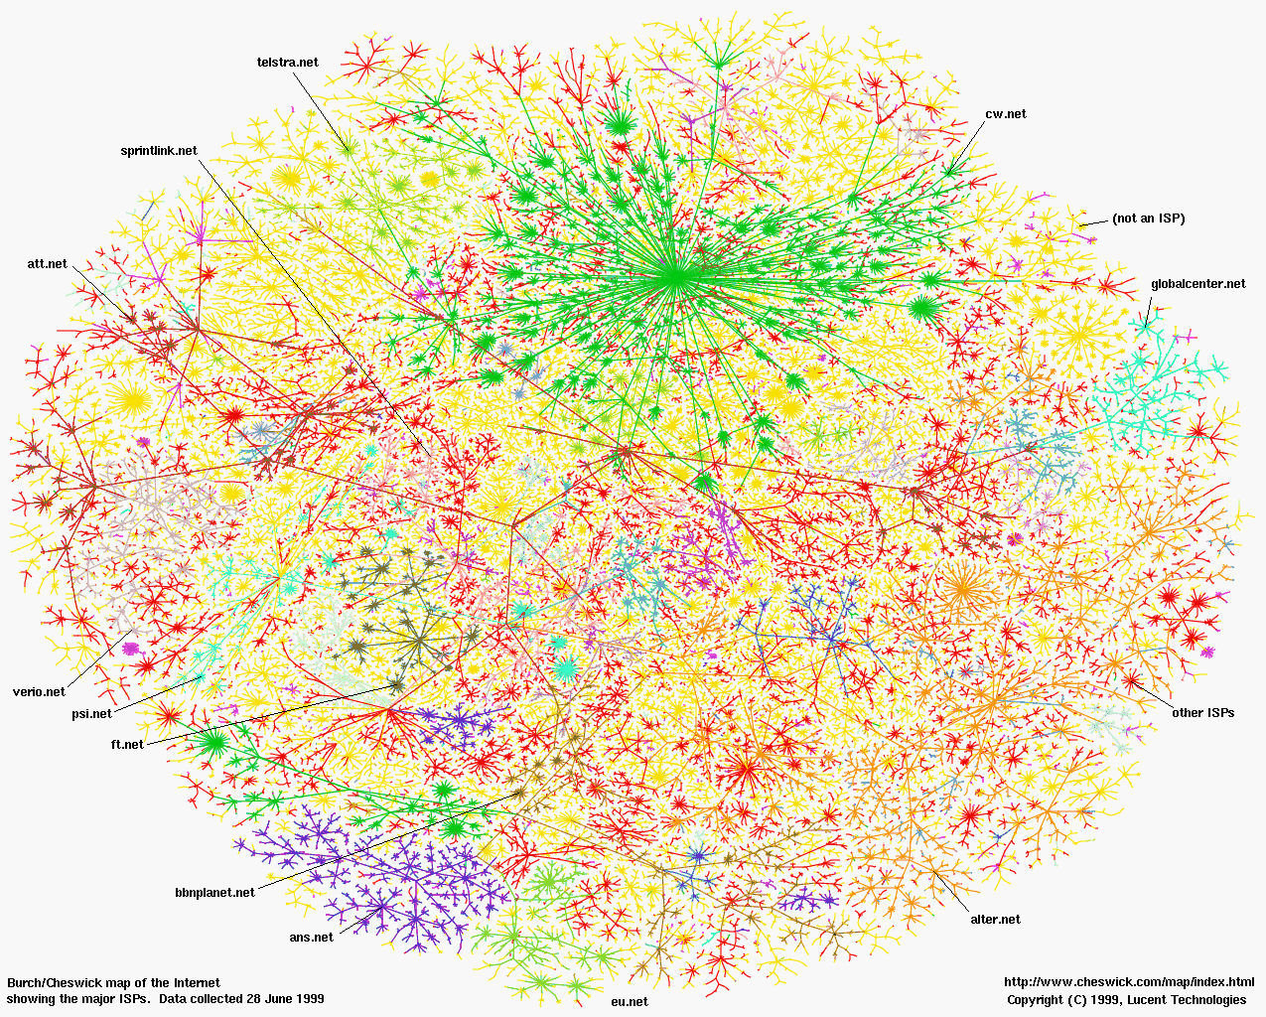
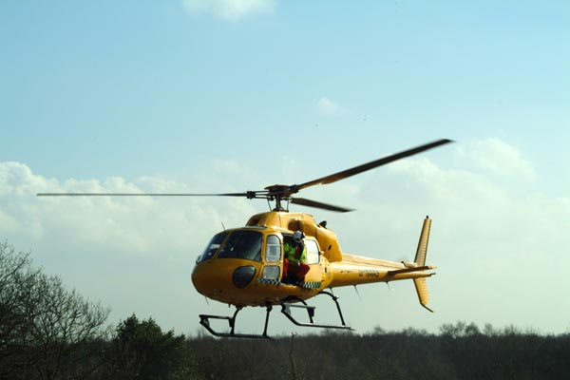
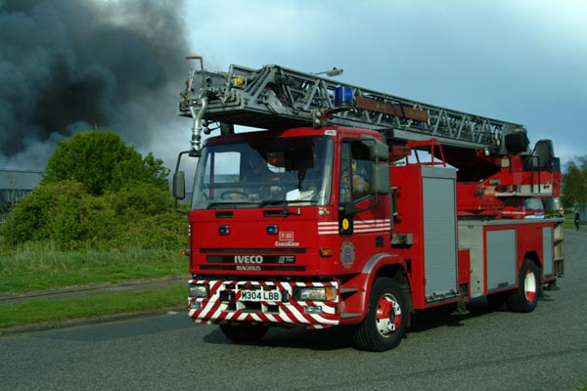
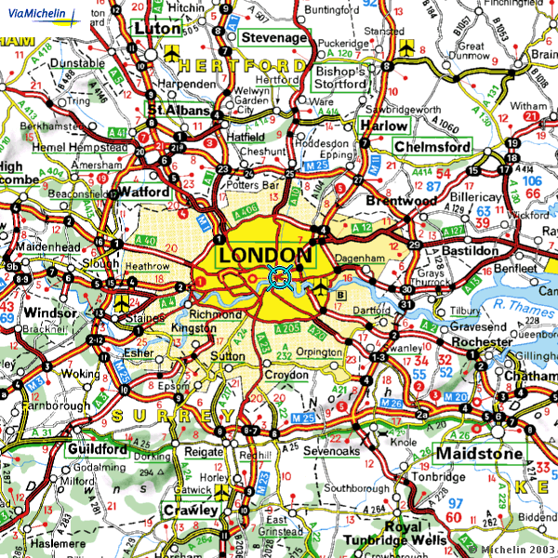
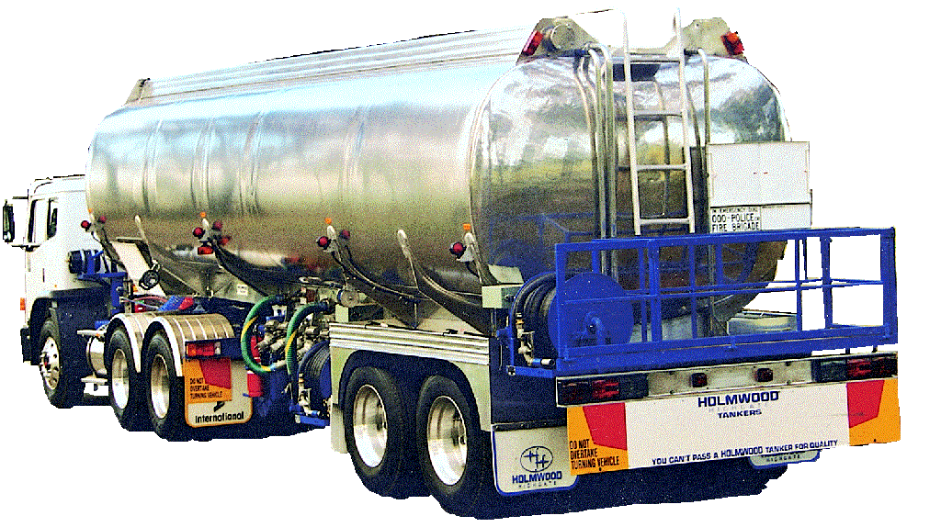
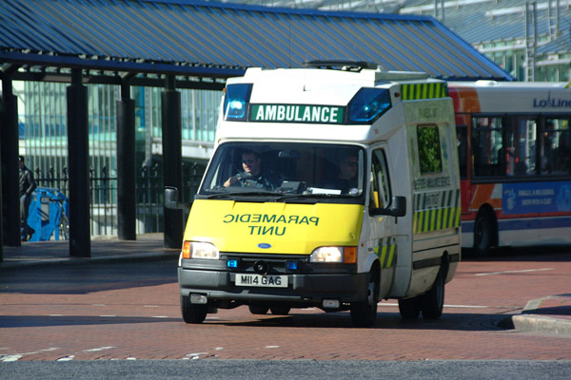
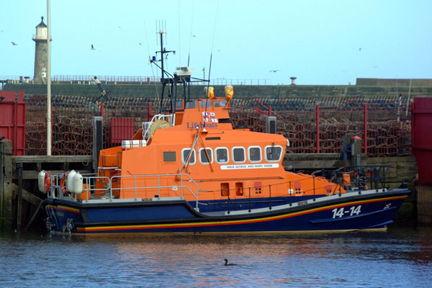
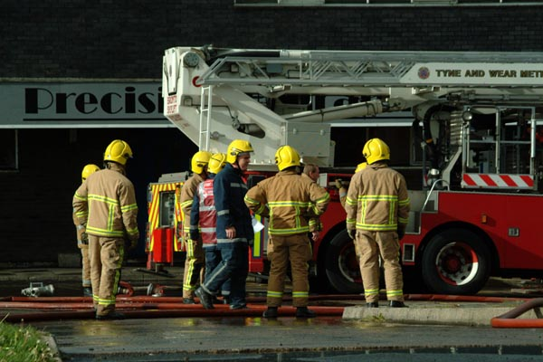
Problems for Planning
Notes:
1975 – Nonlin – UK CEGB - Electricity Turbine Overhaul Procedures
1982 – Deviser based on Nonlin – NASA JPL – Voyager Mission Planning
1996 – OPTIMUM_AIV based on O-Plan – ESA Ariane IV AIV for payload bay
1996-present – Search and Rescue – UK RAF and USA JPRA
Commercial applications for Nynas tanker scheduling and Edify for financial help desks

Slide 5
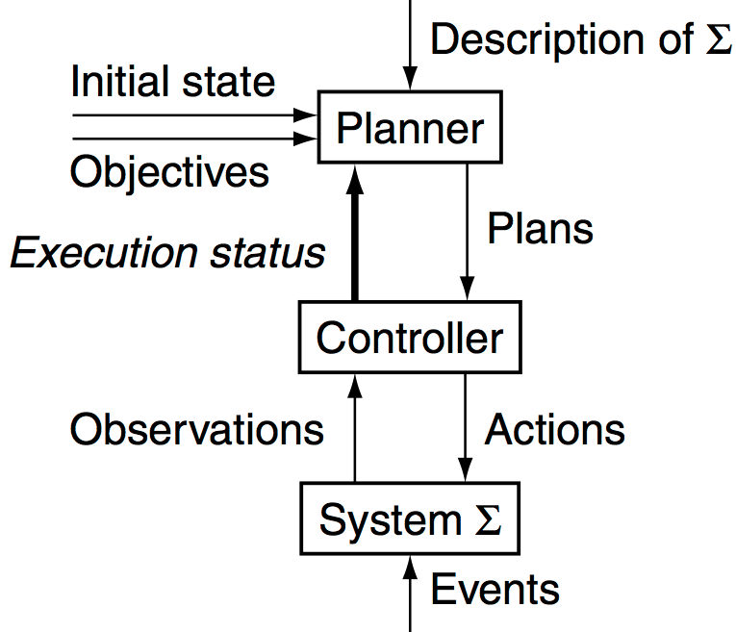
Conceptual Model
1. Environment
State transition system
Σ = (S,A,E,γ)
S = {states}
A = {actions}
E = {exogenous events}
γ = state-transition function
System Σ

Slide 6
State Transition System
s₁
s₀
put
Σ = (S,A,E,γ)
S = {states}
A = {actions}
E = {exogenous events}
State-transition function
γ: S x (A ∪ E) → 2^{S}
  S = {s₀, …, s₅}
  A = {move1, move2, put, take, load, unload}
  E = {}
  γ: see the arrows
take
location 1
location 2
location 1
location 2
move2
move1
move2
move1
s₃
s₂
put
take
location 1
location 2
location 1
location 2
unload
load
s₄
s₅
move2
move1
location 1
location 2
location 1
location 2
The Dock Worker Robots (DWR) domain

Slide 7

Conceptual Model
2. Controller
Controller
Given observation o in O, produces action a in A
Observation function
h: S → O
s₃
location 1
location 2

Slide 8
Conceptual Model
3. Planner’s Input
Planning problem
Planning problem
Planning problem
Planner
Omit unless planning is online

Slide 9
Planning
Problem
s₁
s₀
put
take
Description of Σ
Initial state or set of states
  Initial state = s₀
Objective
  Goal state, set of goal states, set of tasks, “trajectory” of states, objective function, …
  Goal state = s₅
location 1
location 2
location 1
location 2
move2
move1
move2
move1
s₃
s₂
put
take
location 1
location 2
location 1
location 2
unload
load
s₄
s₅
move2
move1
location 1
location 2
location 1
location 2
The Dock Worker Robots (DWR) domain

Slide 10
Conceptual Model
4. Planner’s Output
Planner
Instructions to
the controller

Slide 11
Plans
s₁
s₀
put
Classical plan: a sequence of actions
⟨take, move1, load, move2⟩
Policy: partial function from S into A
{(s₀, take),
(s₁, move1),
(s₃, load),
(s₄, move2)}
take
take
location 1
location 2
location 1
location 2
move1
move2
move1
move2
move1
s₃
s₂
put
take
location 1
location 2
location 1
location 2
load
unload
load
s₄
s₅
move2
move2
move1
location 1
location 2
location 1
location 2
The Dock Worker Robots (DWR) domain

Slide 12
Planning Versus Scheduling
Scheduling
  Decide when and how to
  perform a given set of actions
    Time constraints
    Resource constraints
    Objective functions
  Typically NP-complete
Planning
  Decide what actions to use to achieve some set of objectives
  Can be much worse than NP-complete; worst case is undecidable
Scheduler

Slide 13
Planning Research Areas & Techniques
  Domain Modelling HTN, SIPE
  Domain Description PDDL, NIST PSL
  Domain Analysis TIMS
  Plan Repair O-Plan
  Re-planning O-Plan
  Plan Monitoring O-Plan, IPEM
  Search Methods Heuristics, A*
  Graph Planning Algthms GraphPlan
  Partial-Order Planning Nonlin, UCPOP
  Hierarchical Planning NOAH, Nonlin, O-Plan
  Refinement Planning Kambhampati
  Opportunistic Search OPM
  Constraint Satisfaction CSP, OR, TMMS
  Optimisation Methods NN, GA, Ant Colony Opt.
  Issue/Flaw Handling O-Plan
  Plan Generalisation Macrops, EBL
  Case-Based Planning CHEF, PRODIGY
  Plan Learning SOAR, PRODIGY
  User Interfaces SIPE, O-Plan
  Plan Advice SRI/Myers
  Mixed-Initiative Plans TRIPS/TRAINS
  Planning Web Services O-Plan, SHOP2
  Plan Analysis NOAH, Critics
  Plan Simulation QinetiQ
  Plan Qualitative Mdling Excalibur
  Plan Sharing & Comms I-X, <I-N-C-A>
  NL Generation …
  Dialogue Management …
Notes:
There are many techniques which together offer support for rich planning systems.

Slide 14
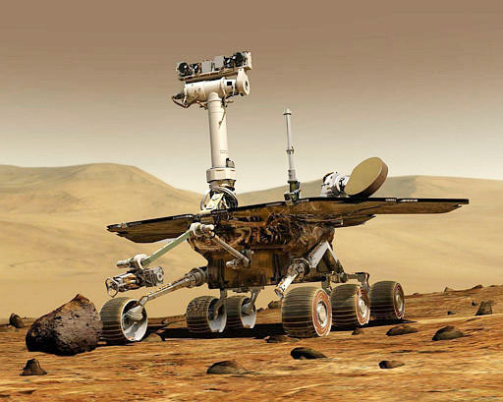
Any Questions?

